Slide 1
Logical Networks
Kobriendublin.wordpress.com
Twitter: @StatsLabdublin

Slide 2
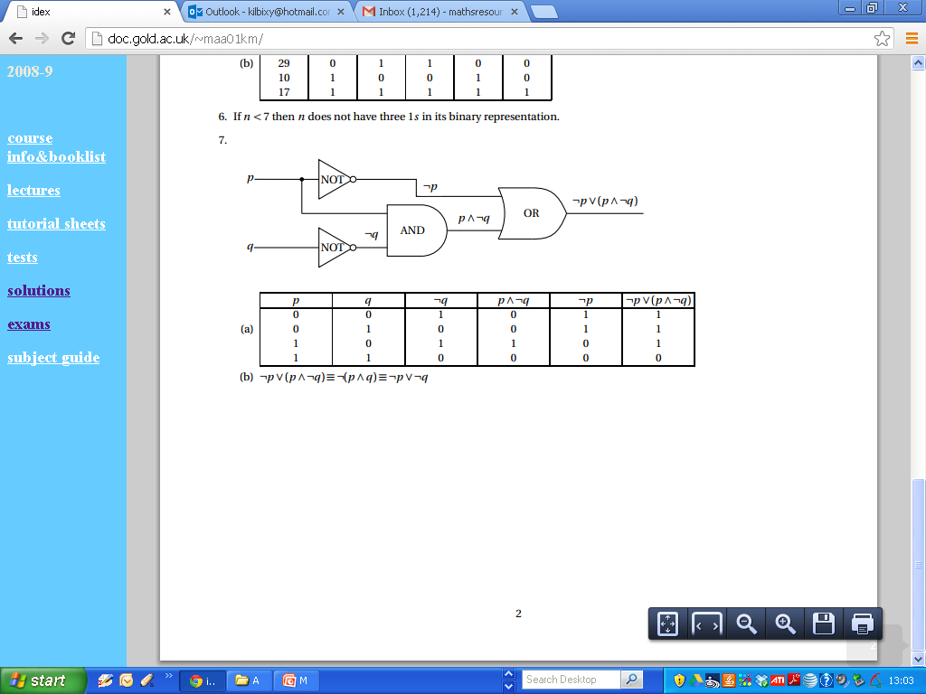
Logical Networks

